Slide 1
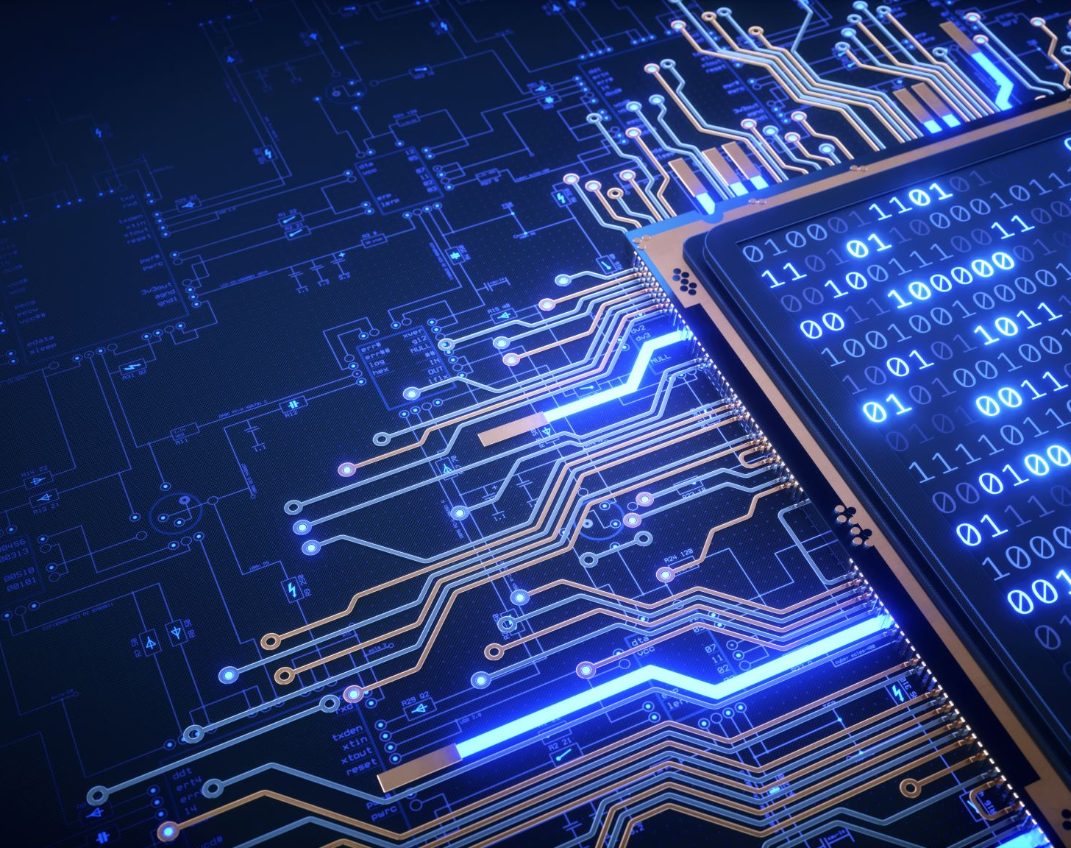
LCD interfacing with LPC 1768
Prepared by:
Kunjal Patel (C0754858)
Group 6

Slide 2
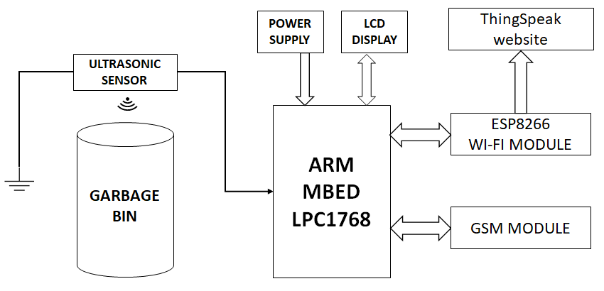
Block Diagram

Slide 3
LPC 1768: PWM
LPC1768 has 6 PWM output pins which can be used as 6-Single edged or 3-Double edged.
Pulse Width Modulation or PWM is a way to encode data such that it corresponds to the width of the pulse given a fixed frequency.
Single Edge PWM - the Pulse can either at the Beginning or the End of the Period .
Double Edge PWM - In Double Edge PWM, the Pulse can be Positioned anywhere within the Period

Slide 4
HD-440780 LCD
The HD44780 contains an 80-byte RAM (random access memory) to hold the display, data, and a ROM (read only memory) for generating the characters.
It has a simple instruction set, including instructions for initialization, cursor control (moving, blanking, blinking), and clearing the display.
Communication with the controller is made via an 8-bit data bus.
This LCD has three control lines (RS, R/W, Busy flag), and an enable/strobe line (E).
We are using PWM Output to interface LCD with LPC 1768.

Slide 5
HD-440780 LCD
The controller can be set up to operate in 8-bit or 4-bit mode.
In the latter mode, only the four most significant bits of the bus are used, and two write cycles are required to send a single byte.
We have used LCD in 4-bit mode in our project.
Only DB4-DB7 data lines can be used in 4-bit mode while in 8-bit mode DB0-DB7 data lines are used.

Slide 6
Interfacing LCD to LPC 1768
As we have mentioned, we have used PWM output technique to interface LCD with LPC 1768.
In LPC 1768 microcontroller, P21-P26 are assigned for PWM output.
Four outputs are required to send the 4-bit instruction and display data and two outputs are required to manipulate the RS and E control lines.

Slide 7
Wiring table for connecting LCD to LPC 1768
mbed Pin Number | LCD Pin number | LCD pin name | Power Connections
1 | 1 | VSS | 0V
39 | 2 | VDD | 5V
1 | 3 | Vo | 0V
19 | 4 | RS
1 | 5 | R/W | 0V
20 | 6 | E
21 | 11 | DB4
22 | 12 | DB5
23 | 13 | DB6
24 | 14 | DB7
39 | 15 | A | 5V
1 | 16 | K | 0V

Slide 8
LCD pin details
RS Register Select: 0 = Instruction register 1 = Data Register
R/W -Selects read or write
E -Synchronizes read and write operations
DB4 - DB7 Higher order bits of data bus; DB7 also used as Busy flag
DB0 - DB3 Lower order bits of data bus; not used for 4-bit operation

Slide 9
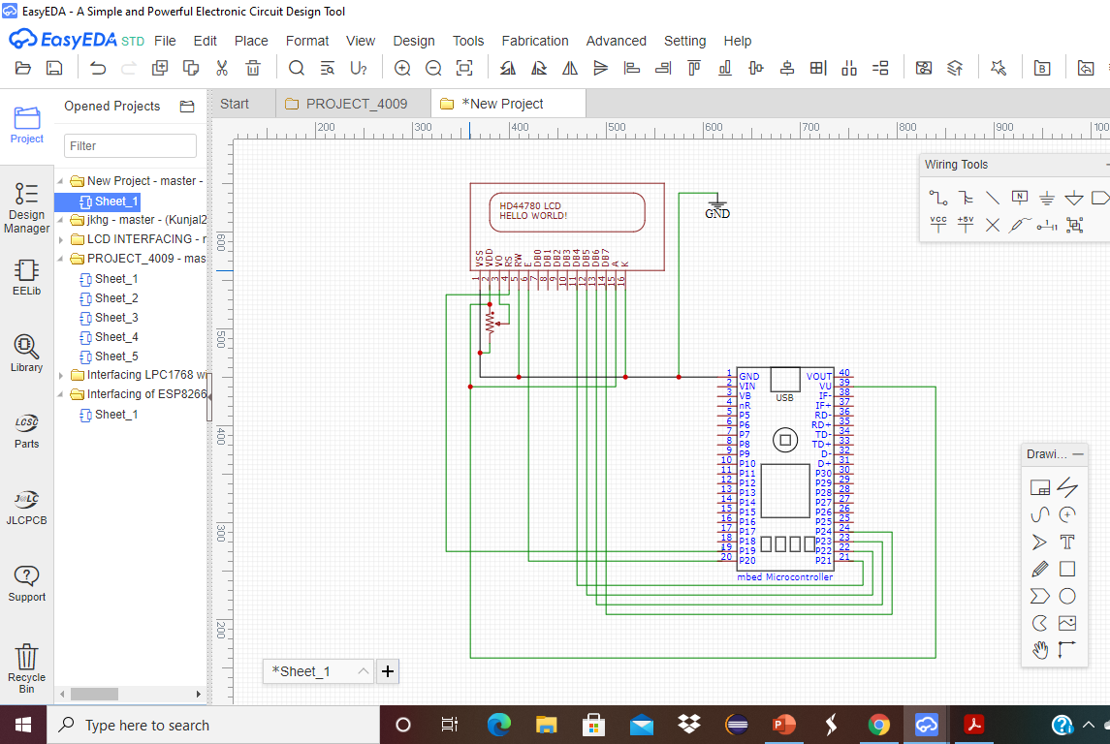
Interfacing LCD to LPC 1768

Slide 10
Detailed Procedure of Interfacing LCD with LPC 1768
We can interface the mbed processor to an external LCD, to display messages on the screen. Interfacing an LCD requires a few involved steps to prepare the device and achieve the desired display. The following tasks must be considered to successfully interface the LCD:
Hardware integration: we will need to connect the LCD to the correct mbed pins.
Modular coding: As there are many processes that need to be completed, it makes sense to define LCD functions in modular files.
Initializing the LCD: A specific sequence of control signals must be sent to the LCD to initialize it.
Outputting data: We will need to understand how the LCD converts control data into legible display data.

Slide 11
Modular coding:
Initializing and interfacing a peripheral device, such as an LCD, can be done effectively by using modular files to define various parts of the code.
a main code file (main.cpp) which can call functions defined in the LCD feature file
an LCD definition file (LCD.cpp) which will include all the functions for initializing and sending data to the LCD,
an LCD header file (LCD.h) which will be used to declare data and function prototypes

Slide 12
Initializing the LCD
Once we have verified all the connections from MCU to LCD Module, we can go ahead to display text on the LCD.
Before initializing the LCD, we need to wait for a minimum time of about 15 milliseconds after the input voltage supply is stable and greater than 4.5 Volts.
Make sure that the RS and Enable are held LOW.
Next step is to input some commands to the LCD using the Data pins. These commands will not be executed until a pulse is supplied to the Enable pin.

Slide 13
Initializing the LCD
After supplying the command with a pulse, Enable must be made High and then Low after a short delay.
We then need to send configuration data to the Function Mode, Display Mode, and Clear Display registers to initialize the display.
To set LCD Function Mode, the RS, R/W, and DB0-7 bits should be set accordingly, and data bus values are of course sent as two nibbles.
To define 4-bit mode in LCD, we can send a binary value of 00101000 (0x28 hex) to the LCD data pins, 2-line display, and 5x7 dot characters.
We would therefore send the value 0x2, pulse E, then send 0x8, then pulse E again.

Slide 14
Function mode control register
Here, in this Function mode control register, we can set
DL=0 → 4-bit mode
DL=1 → 8-bit mode
N = 0 → 1 line mode
N = 1 → 2 line mode
F = 0 → 5×7 pixels
F = 1 → 5×10 pixels

Slide 15
Display Mode
The Display Mode control register must also be set up during initialization. Here we need to send a command
to switch the display on
to determine the cursor function
To switch the display on with a blinking cursor, the value 0x0F (in two 4-bit nibbles) is required.

Slide 16
Display Mode control register
RS | R/W | DB7 | DB6 | DB5 | DB4 | DB3 | DB2 | DB1 | DB0
0 | 0 | 0 | 0 | 0 | 0 | 1 | P | C | B
P = 0 → display off C = 0 → cursor off B = 0 → cursor no blink
P = 1 → display on C = 1 → cursor on B = 1 → cursor blinking

Slide 17
Clear Display
Before data can be written to the display, the display must be cleared.
the cursor reset to the first character in the first row.
The clear display command are shown as below:
RS | R/W | DB7 | DB6 | DB5 | DB4 | DB3 | DB2 | DB1
0 | 0 | 0 | 0 | 0 | 0 | 0 | 0 | 1

Slide 18
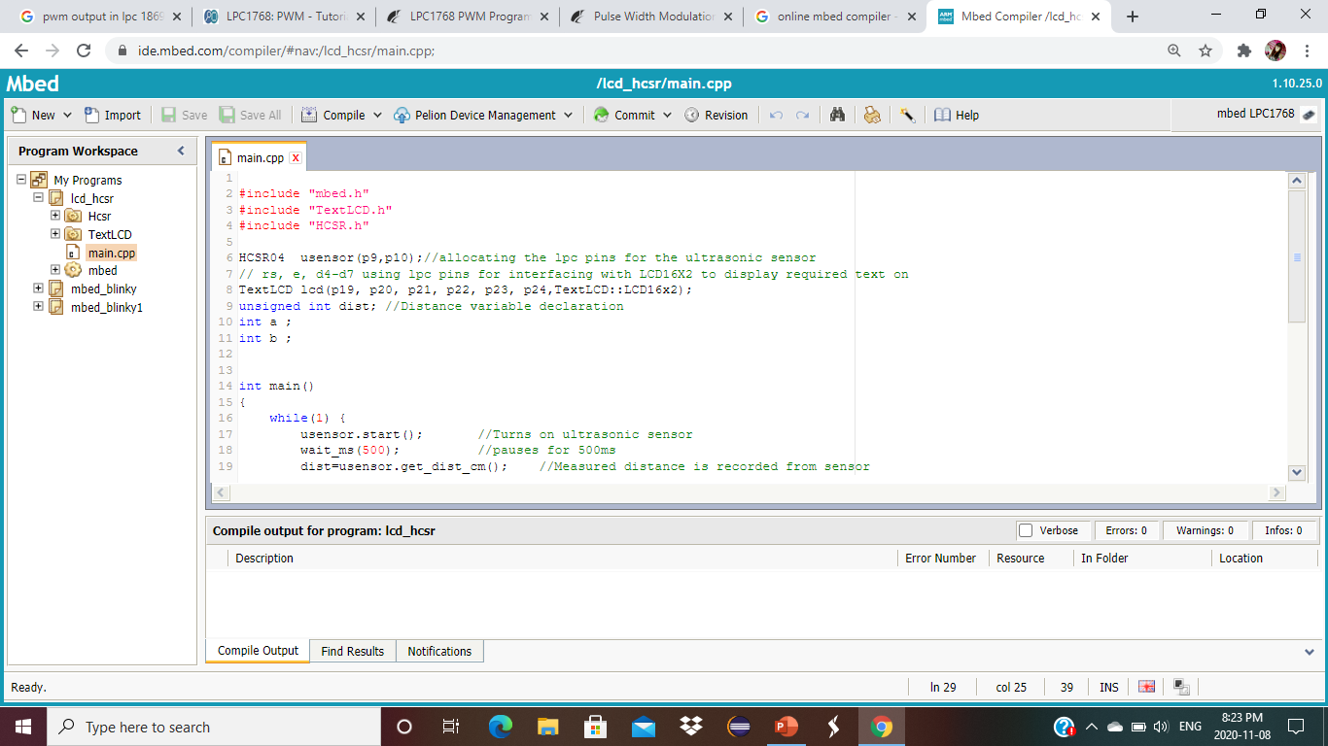
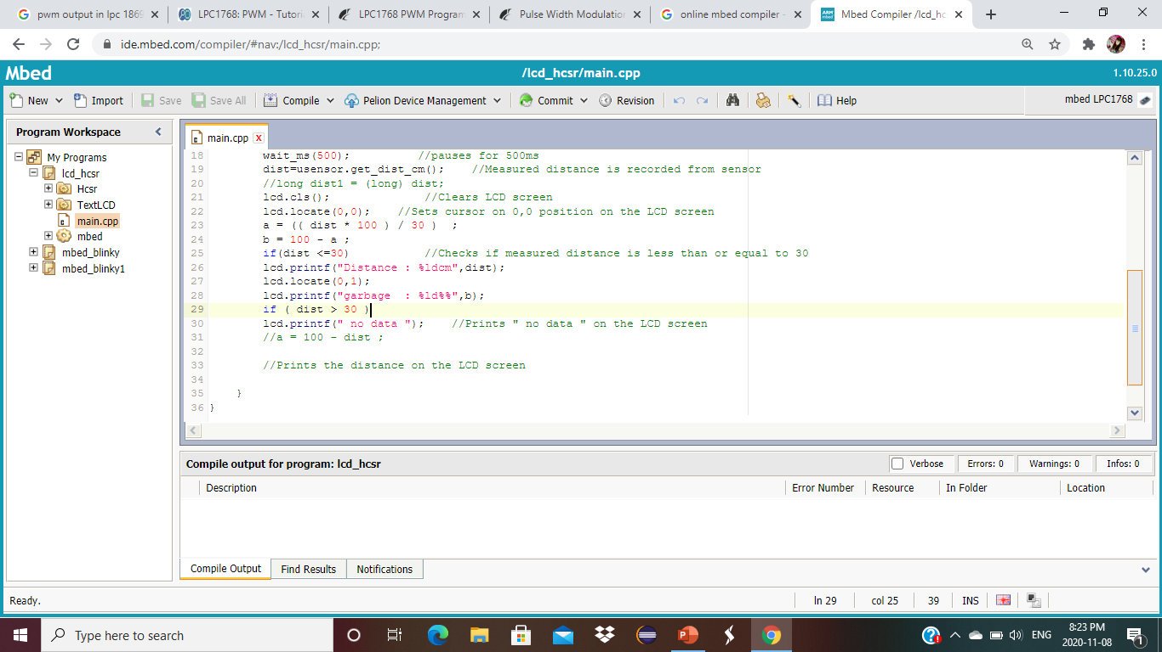
Coding

Slide 19
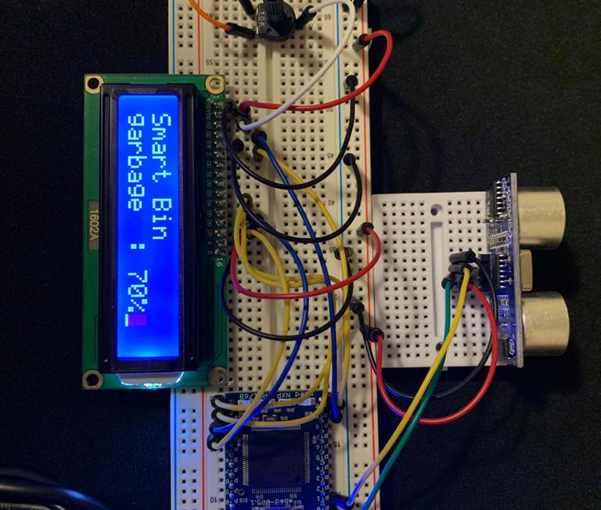
LCD interfacing with LPC 1768

Slide 20
References
P.M, P. (2019, July 12). LCD interface in 4bit mode with LPC1768- (Part 5/21). Retrieved November 06, 2020, from https://www.engineersgarage.com/arm/lcd-interface-in-4bit-mode-with-lpc1768-part-5-21/
16x2 Character LCD Interfacing using LPC1768. (2020, May 11). Retrieved November 06, 2020, from https://openlabpro.com/guide/16x2-character-lcd-interfacing-using-lpc1768/
Pulse Width Modulation (PWM) Tutorial. (2013, August 21). Retrieved November 09, 2020, from http://www.ocfreaks.com/pulse-width-modulation-pwm-tutorial/

